Slide 1

MICROWAVE OVEN
SIMULATOR
Presented By
N.Abinayasri
S.Gayathri
E.Harshini

Slide 2
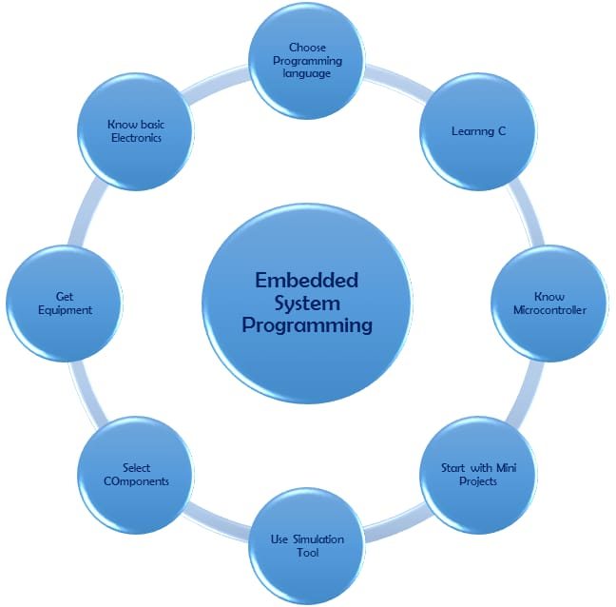
INTERNSHIP OVERVIEW
Introduction to Embedded system
Basics of C programming
Microchip embedded program for toggling the LEDs
Microwave oven simulator standalone project

Slide 3
C PROGRAMMING
C is an efficient and widely used programming language.
Industry estimates say 80% of embedded system use the c programming language
Embedded C programming plays a key role in performing specific function by the processor

Slide 4
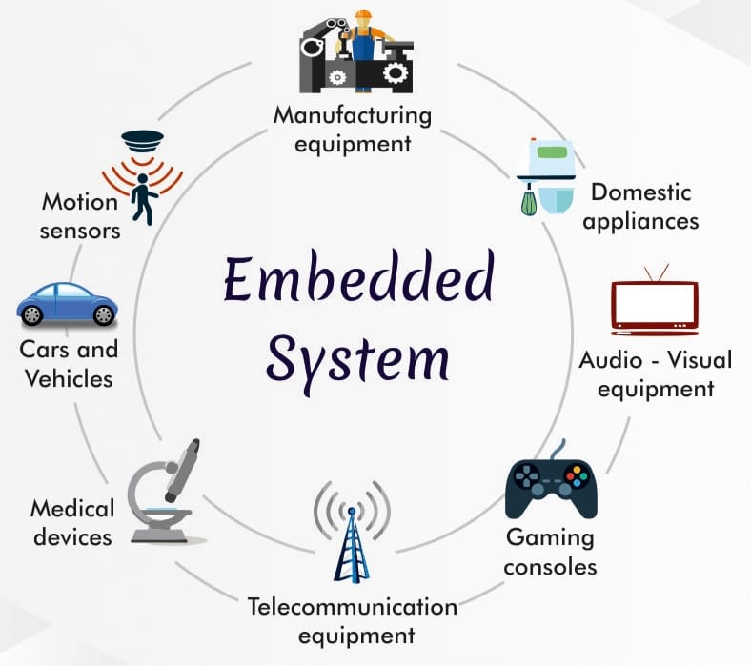
EMBEDDED SYSTEM
“Any combination of Hardware and Software which is intended to do a specific task can be called as an Embedded System”

Slide 5
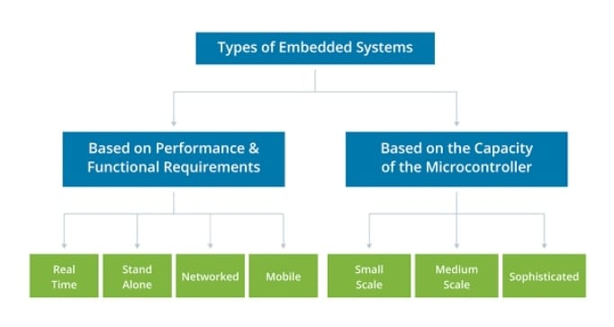

Slide 6
REAL TIME EMBEDDED SYSTEMS
HARD REAL TIME
Systems where it is absolutely imperative that responses occur within the required deadline.
Ex. Flight Control systems
SOFT REAL TIME
Systems where deadlines are important but which will still function correctly if deadlines are occasionally missed.
Ex. Data acquisition system
REAL REAL TIME
Systems which are hard real time and which the response times and very short.
Ex. Missile guidance system
FIRM REAL TIME
Systems which are soft real time but in which there is no benefit from late delivery of service.
Ex. Financial forecast systems

Slide 7
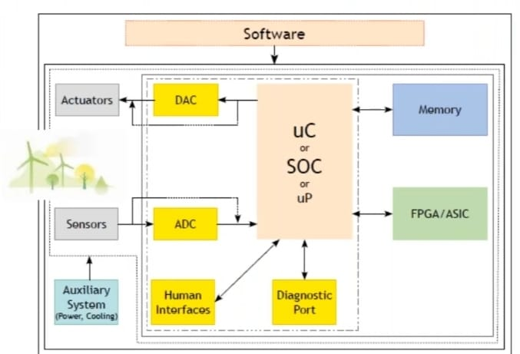
COMPONENTS OF EMBEDDED SYSTEM

Slide 8
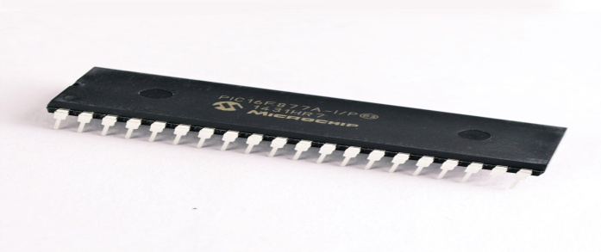
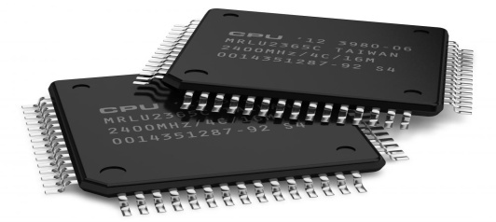
MICROCONTROLLER
An integrated circuit that contains a microprocessor along with memory and associated circuits and that controls some or all of the functions of an electronic device(such as a home appliance) or system
MICROPROCESSOR
The microprocessor is a programmable device that takes in numbers , performs on them arithmetic or logical operations according to the program stored in memory and then produces other numbers as a result

Slide 9


Slide 10


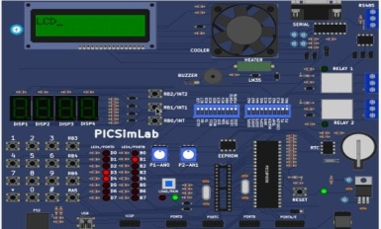
TOOLS REQUIRED FOR MICROWAVE OVEN SIMULATION PROECT
MPLAB X IDE
MPLAB XC8 Compiler
PICSimLab Simulator

Slide 11
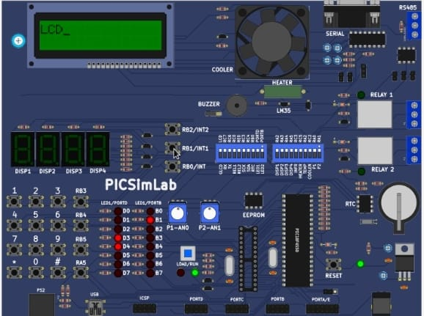

Slide 12
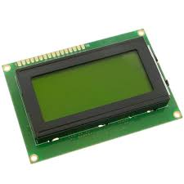
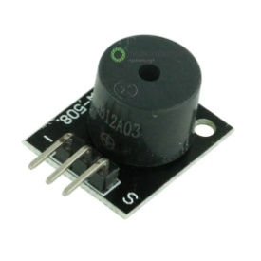
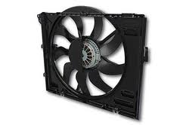
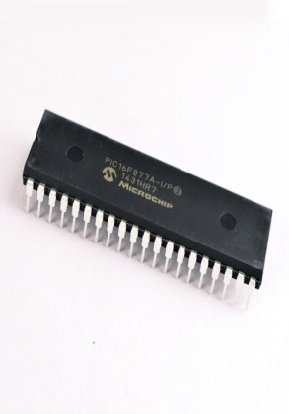
Microwave oven simulator Peripherals
Timer
LCD
Buzzer
Cooler
Tactile Switch / Keys
Door Open Sensor
Microcontroller

Slide 13
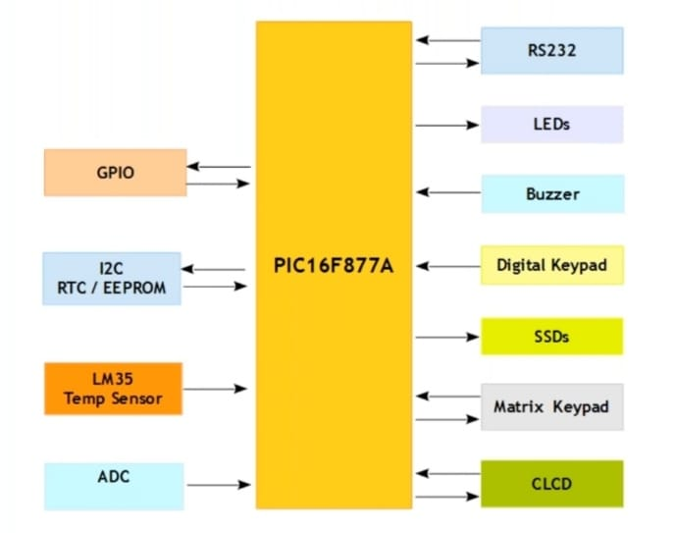
PICSimLab ARCHITECTURE

Slide 14
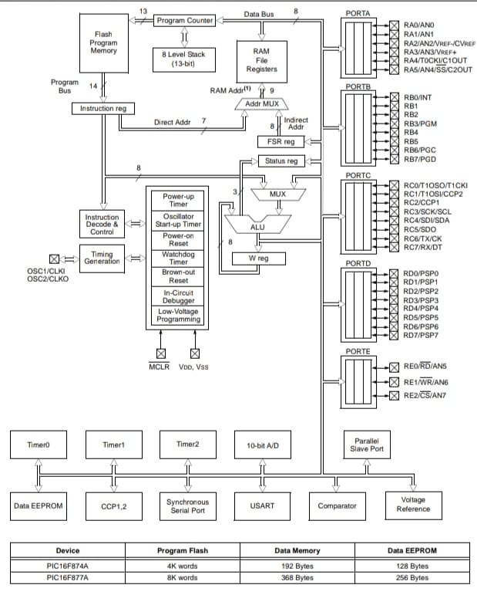
PIC16F877A

Slide 15
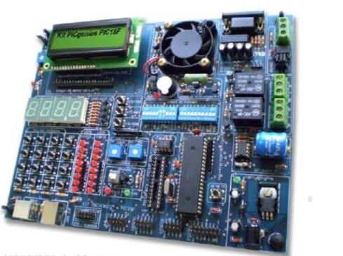
INTERFACES
LED s
Interrupts
Timers
Clock I/O
SSDs
CLCD
Matrix Keypad
Analog Inputs

Slide 16
CLCD
CLCD – Character Liquid Crystal Display.
It has two types of display ,they are 16*2 and 16*4.
It is used to display all ASCII character and symbol .It has totally 16 interfacing lines.
INTERFACING LINES
1 | 2 | 3 | 4 | 5 | 6 | 7 | 8 | 9 | 10 | 11 | 12 | 13 | 14 | 15 | 16
Vss | Vdd | Vo | RS | R/W | E | D0 | D1 | D2 | D3 | D4 | D5 | D6 | D7 | A | K
D0 to D7 are data line .it has built in controller.It has own ROM and RAM .That controller can execute the INSTRUCTION and DATA.
RS line –REGISTER SELECT LINE.
RS Value is 0 →Instruction
RS Value is 1 →Data

Slide 17
Data processd by two methods
➔Delay Method
➔ Poll D7 Method
In poll D7 Method ,we want to continuously monitor D7.In data lines , we are providing data.
R/W=1→Read
R/W=0→Write
In R/W pin is permanently grounded .that means only write an data .
In CLCD D0 to D7 are connected to port D & RS and enable pin are connected to port E.
8 bit→D0 to D7
4 bit→D4to D7
Enable pin act as indicator by apprising LCD about the inception of data transmission by the microcontroller .

Slide 18
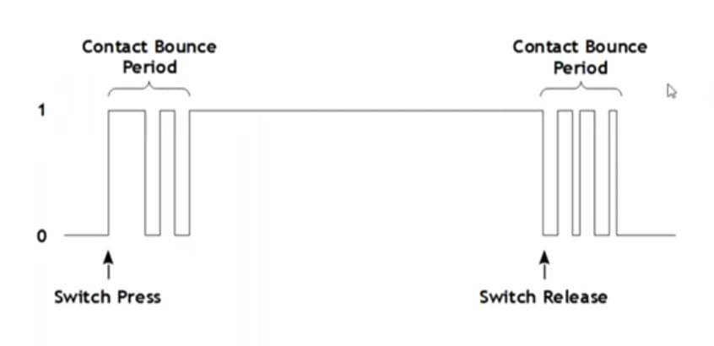
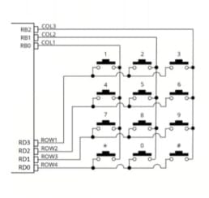
TRIGGERING METHODS
Level Triggering
Edge (State change) Triggering
BOUNCING EFFECT
Matrix Keypads are used in
Telephonic,
Calculators,
Digital Lockers ..

Slide 19
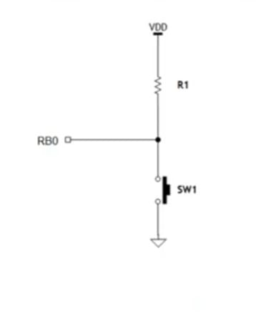
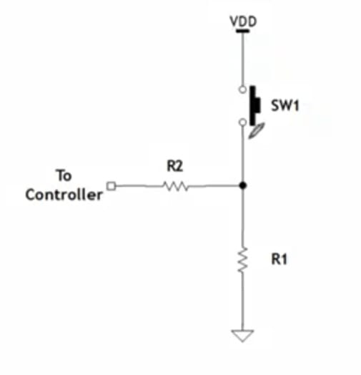
Matrix keypad
Tactile keys are connected in rows and columns
Rows as Output and Columns as Input
PULL UP INTERFACE | PULL DOWN INTERFACE
SWITCH STATUS | MC PIN (SIGNAL)
OPEN | 1
CLOSE | 0
SWITCH STATUS | MC PIN (SIGNAL)
OPEN | 0
CLOSE | 1

Slide 20
interrupt
An interrupt is a communication process set up in a microprocessor or microcontroller in which:
An internal or external device requests the MPU to stop the processing.
The MPU acknowledge the request
Attends to the requests
Goes back to processing where it was interrupted
INTERRUPTS
HARDWARE
NON MASKABLE
MASKABLE
SOFTWARE

Slide 21
INTERRUPT HANDLER
IVT - Interrupt Vector Table
ISR – Interrupt Service Routine
ISR
When an interrupt occurs,the MPU :
Completes the instruction being executed
Disables global interrupt enable(GIE)
Places the address from the program counter on the stack
Return from interrupt
In PIC16F877A, there are15 sources of interrupts
Individual Enable Bit – individual interrupt request in flag bits
Global Enable Bit – GIE=1,enables all(if set) unmasked interrupts
GIE=0,disables all interrupts
INTERRUPT LATENCY
Determined by instruction time
How much of the context must be saved and restored
The effort to implement priority scheme
Time spend xecuting protected code

Slide 22
timers
It is a default peripheral in every microcontroller.Used to capture/calculate time
Modes
-> Counter
->PWM or Pulse generator
->PW or PP Measurement ..
TMR – Tmer Register (8 bit)
Tick based on Instruction Cycle (IC)
IC = t = 1/f ; f = 20 MHz
1 IC = 4 Pules ; 1 IC time = 4*(1/f)
1 IC time = 200 ns
Resolution | Register Width
Tick | Up Count (or) Down Count
Quantum(Period of Tick) | System clock settings
Scaling | Pre-scale (or) Post-scale

Slide 23
timer modules
Timer 0
Timer 1
Timer 2

Slide 24
PROJECT – MICROWAVE OVEN SIMULATION
MICROWAVE OVEN
A microwave oven is an electric oven that heats and cooks food by exposing it to electromagnetic radiation in the microwave frequency range
Using PICSimLab, in picGenios board load .Hex file can execute the simation of microwave oven in PIC16F877A microcontroller
Printing power on message
Different modes of cooking
Micro
Grill
Convection
Start
1,2,3,4.. are the indicating keys of respective modes
By pressing the start key 4, Time = 00 : 30
4. Start
5. Pause
6. Stop

Slide 25
Again pressing 4,time incremented by 30 seconds,press 5 for pause,after pause,pressing start key only resumes the time.
By pressing 6,stop key it goes to cooking mode screen
Time Up! Will display with buzzer sound after the cooking time over
Micro (1)
In this mode,microwave oven power will display and then
Set Time(MM:SS)
Time : 00:00 →can give and change timing while blinking
*:CLEAR #:ENTER
After setting some time 4.Start
5.Pause
6.Stop will display.
The key RB3 acts as door open ,by pressing the key buzzer sound occurs
Grill(2)
Set Time(MM:SS)
Time:: 00:00
*:CLEAR #:ENTER
Cooler runs upto give time,same 4.Start screen displays.
5.Pause
6.Stop

Slide 26
Convection(3)
In this mode,temperature have to be set in Celcius.After pre-heating of 180 seconds.Set time sreen will display
Set Temp
Temp: 000
*:CLEAR #:ENTER
Pre-Heating
Time Rem = 180 sec
Set Time(MM:SS)
Time-00:00
*:CLEAR #:ENTER
After giving time ,press #
4.Start
5.Pause
6.Stop
Time Up! screen will display
Thus the Microwave oven simulation uing PICSimlab PicGenios board is successfully completed

Slide 27
Thank you

